Slide 1
Statistics 367-1-4361 MCMC
Opher Donchin

Slide 2
5A Review

Slide 3
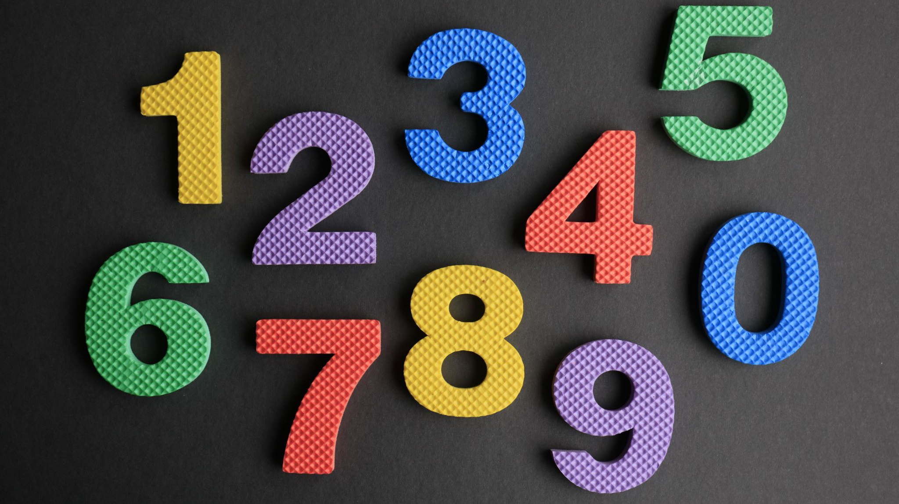
Kahoot time!!
Back in a second!

Slide 4
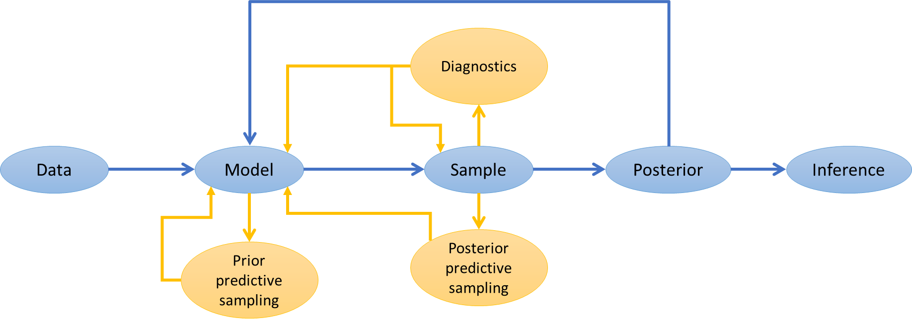
Bayesian workflow
Bayesian workflow guides data analysis from start to finish.
Each step influences modeling decisions and inference.
Each step has its own tools n

Slide 5
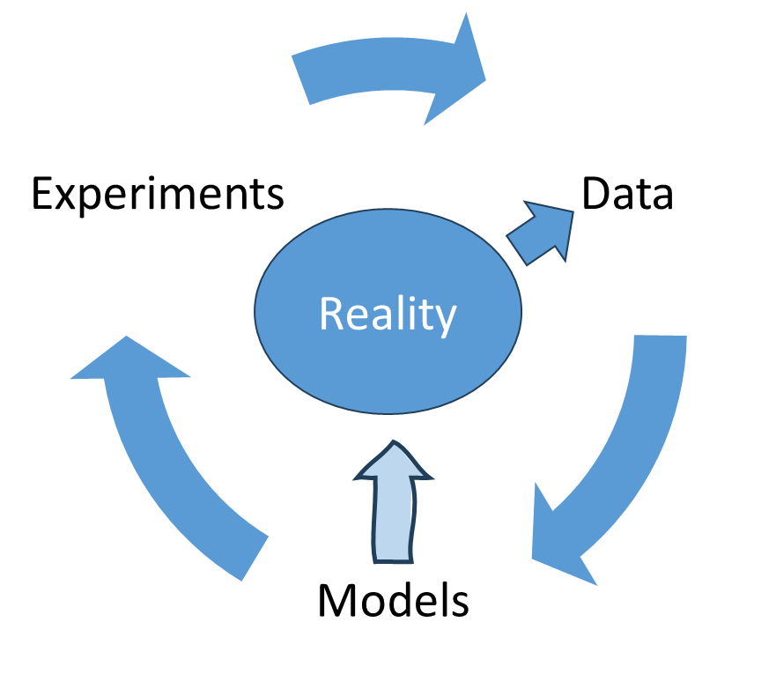
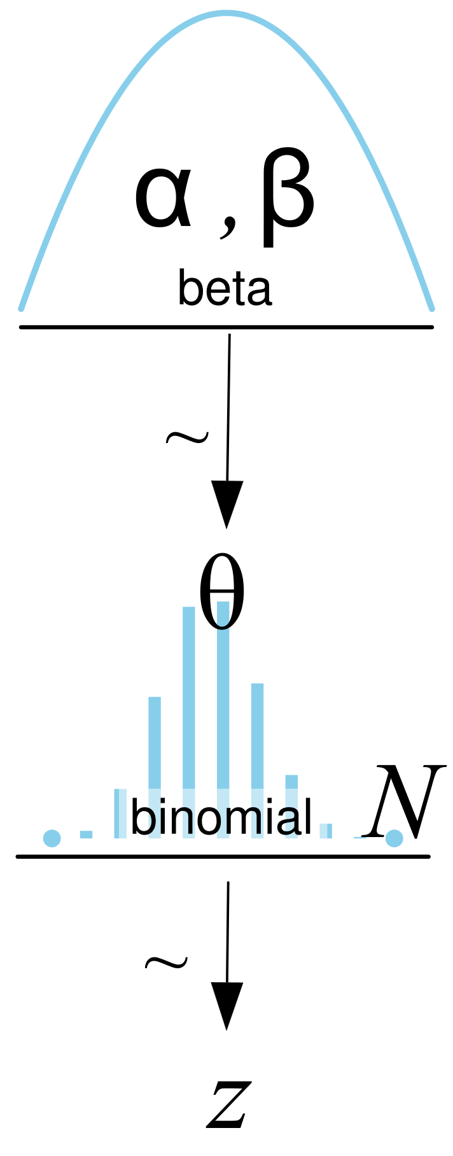
Modelling

Slide 6
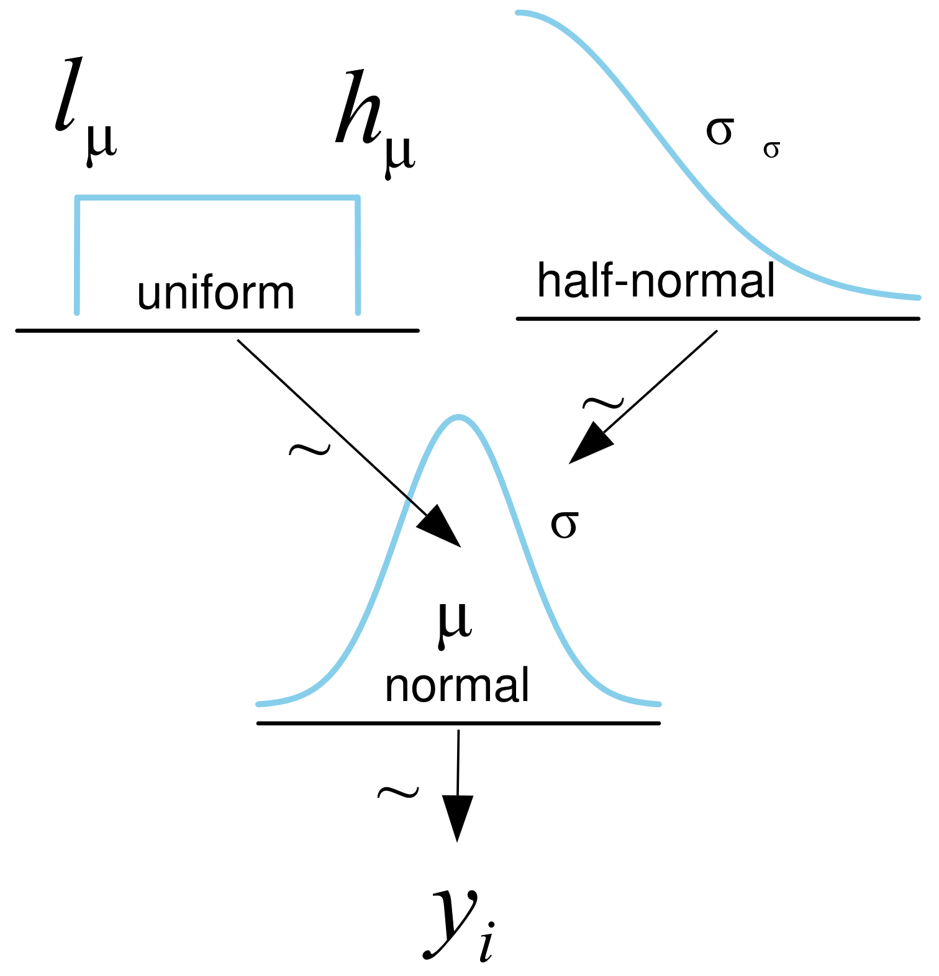
Priors in the Bayesian workflow
Each parameter has a prior distribution

Slide 7
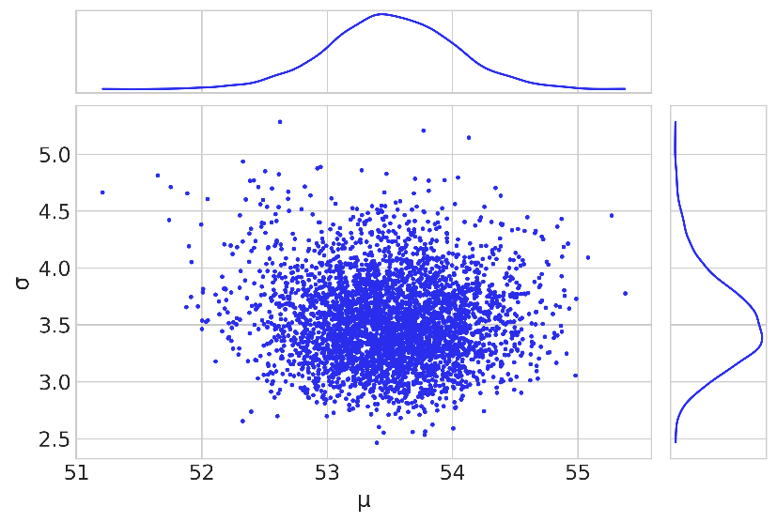
Sampling in the Bayesian workflow

Slide 8
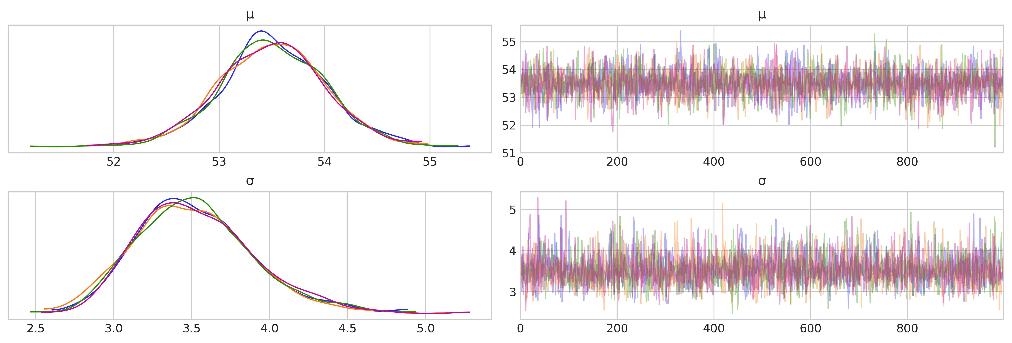
Multiple traces measure sampling consistency
See:
Mixing of chains
Overlap of posteriors
Shape of posteriors

Slide 9
5B Automatic inference

Slide 10
Bayesian workflow
Diagnostics
Data
Model
Sample
Posterior
Inference
Posterior predictive sampling
Prior predictive sampling

Slide 11
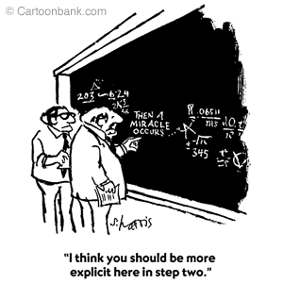
What does automatic inference do
Start with a model and data
Call “sample”
Get samples
How does that work?
How can you go from a model and data to samples?

Slide 12
The history of Bayesian inference
Analytic solutions
Only worked for a few problems
Computers make things faster
Works for more problems
MCMC algorithms
Works for many problems
HMC algorithms
Works much more quickly and reliably
It really is a miracle!
But how does it work?

Slide 13
5C Grid computing

Slide 14
The grid method
“Sample” at fixed intervals
Posterior is just prior times likelihood
And these are both easy to calculate
def posterior_grid(grid_points=50, heads=6, tails=9):
"""
A grid implementation for the coin-flipping problem
"""
grid = np.linspace(0, 1, grid_points)
prior = np.repeat(1/grid_points, grid_points) # uniform prior
likelihood = pz.Binomial(n=heads+tails, p=grid).pdf(heads)
posterior = likelihood * prior
posterior /= posterior.sum() * (1/grid_points)
return grid, posterior

Slide 15
Calculate first, normalize later
Normalizing is easy after you have the samples
def posterior_grid(grid_points=50, heads=6, tails=9):
"""
A grid implementation for the coin-flipping problem
"""
grid = np.linspace(0, 1, grid_points)
prior = np.repeat(1/grid_points, grid_points) # uniform prior
likelihood = pz.Binomial(n=heads+tails, p=grid).pdf(heads)
posterior = likelihood * prior
posterior /= posterior.sum() * (1/grid_points)
return grid, posterior

Slide 16
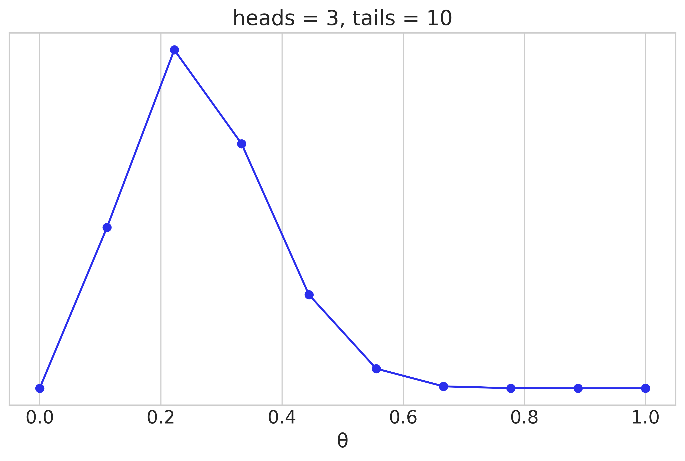
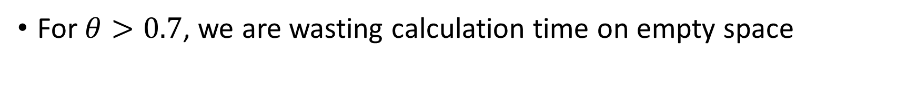
The posterior estimated with a grid
For $θ>0.7$, we are wasting calculation time on empty space
data = np.repeat([0, 1], (10, 3))
points = 10
h = data.sum()
t = len(data) - h
grid, posterior = posterior_grid(points, h, t)
plt.plot(grid, posterior, 'o-')
Approximating integrals

Slide 17
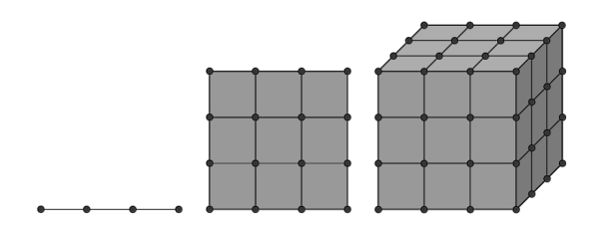
Limitations of grid computation
No focus on high probability areas
Curse of dimensionality
1 parameter: 100 samples
2 parameters: 1,000 samples
3 parameters: 100,000 samples
Real models can have 10s, 100s, or 1000s of parameters

Slide 18
5D Monte-Carlo Markov Chain

Slide 19
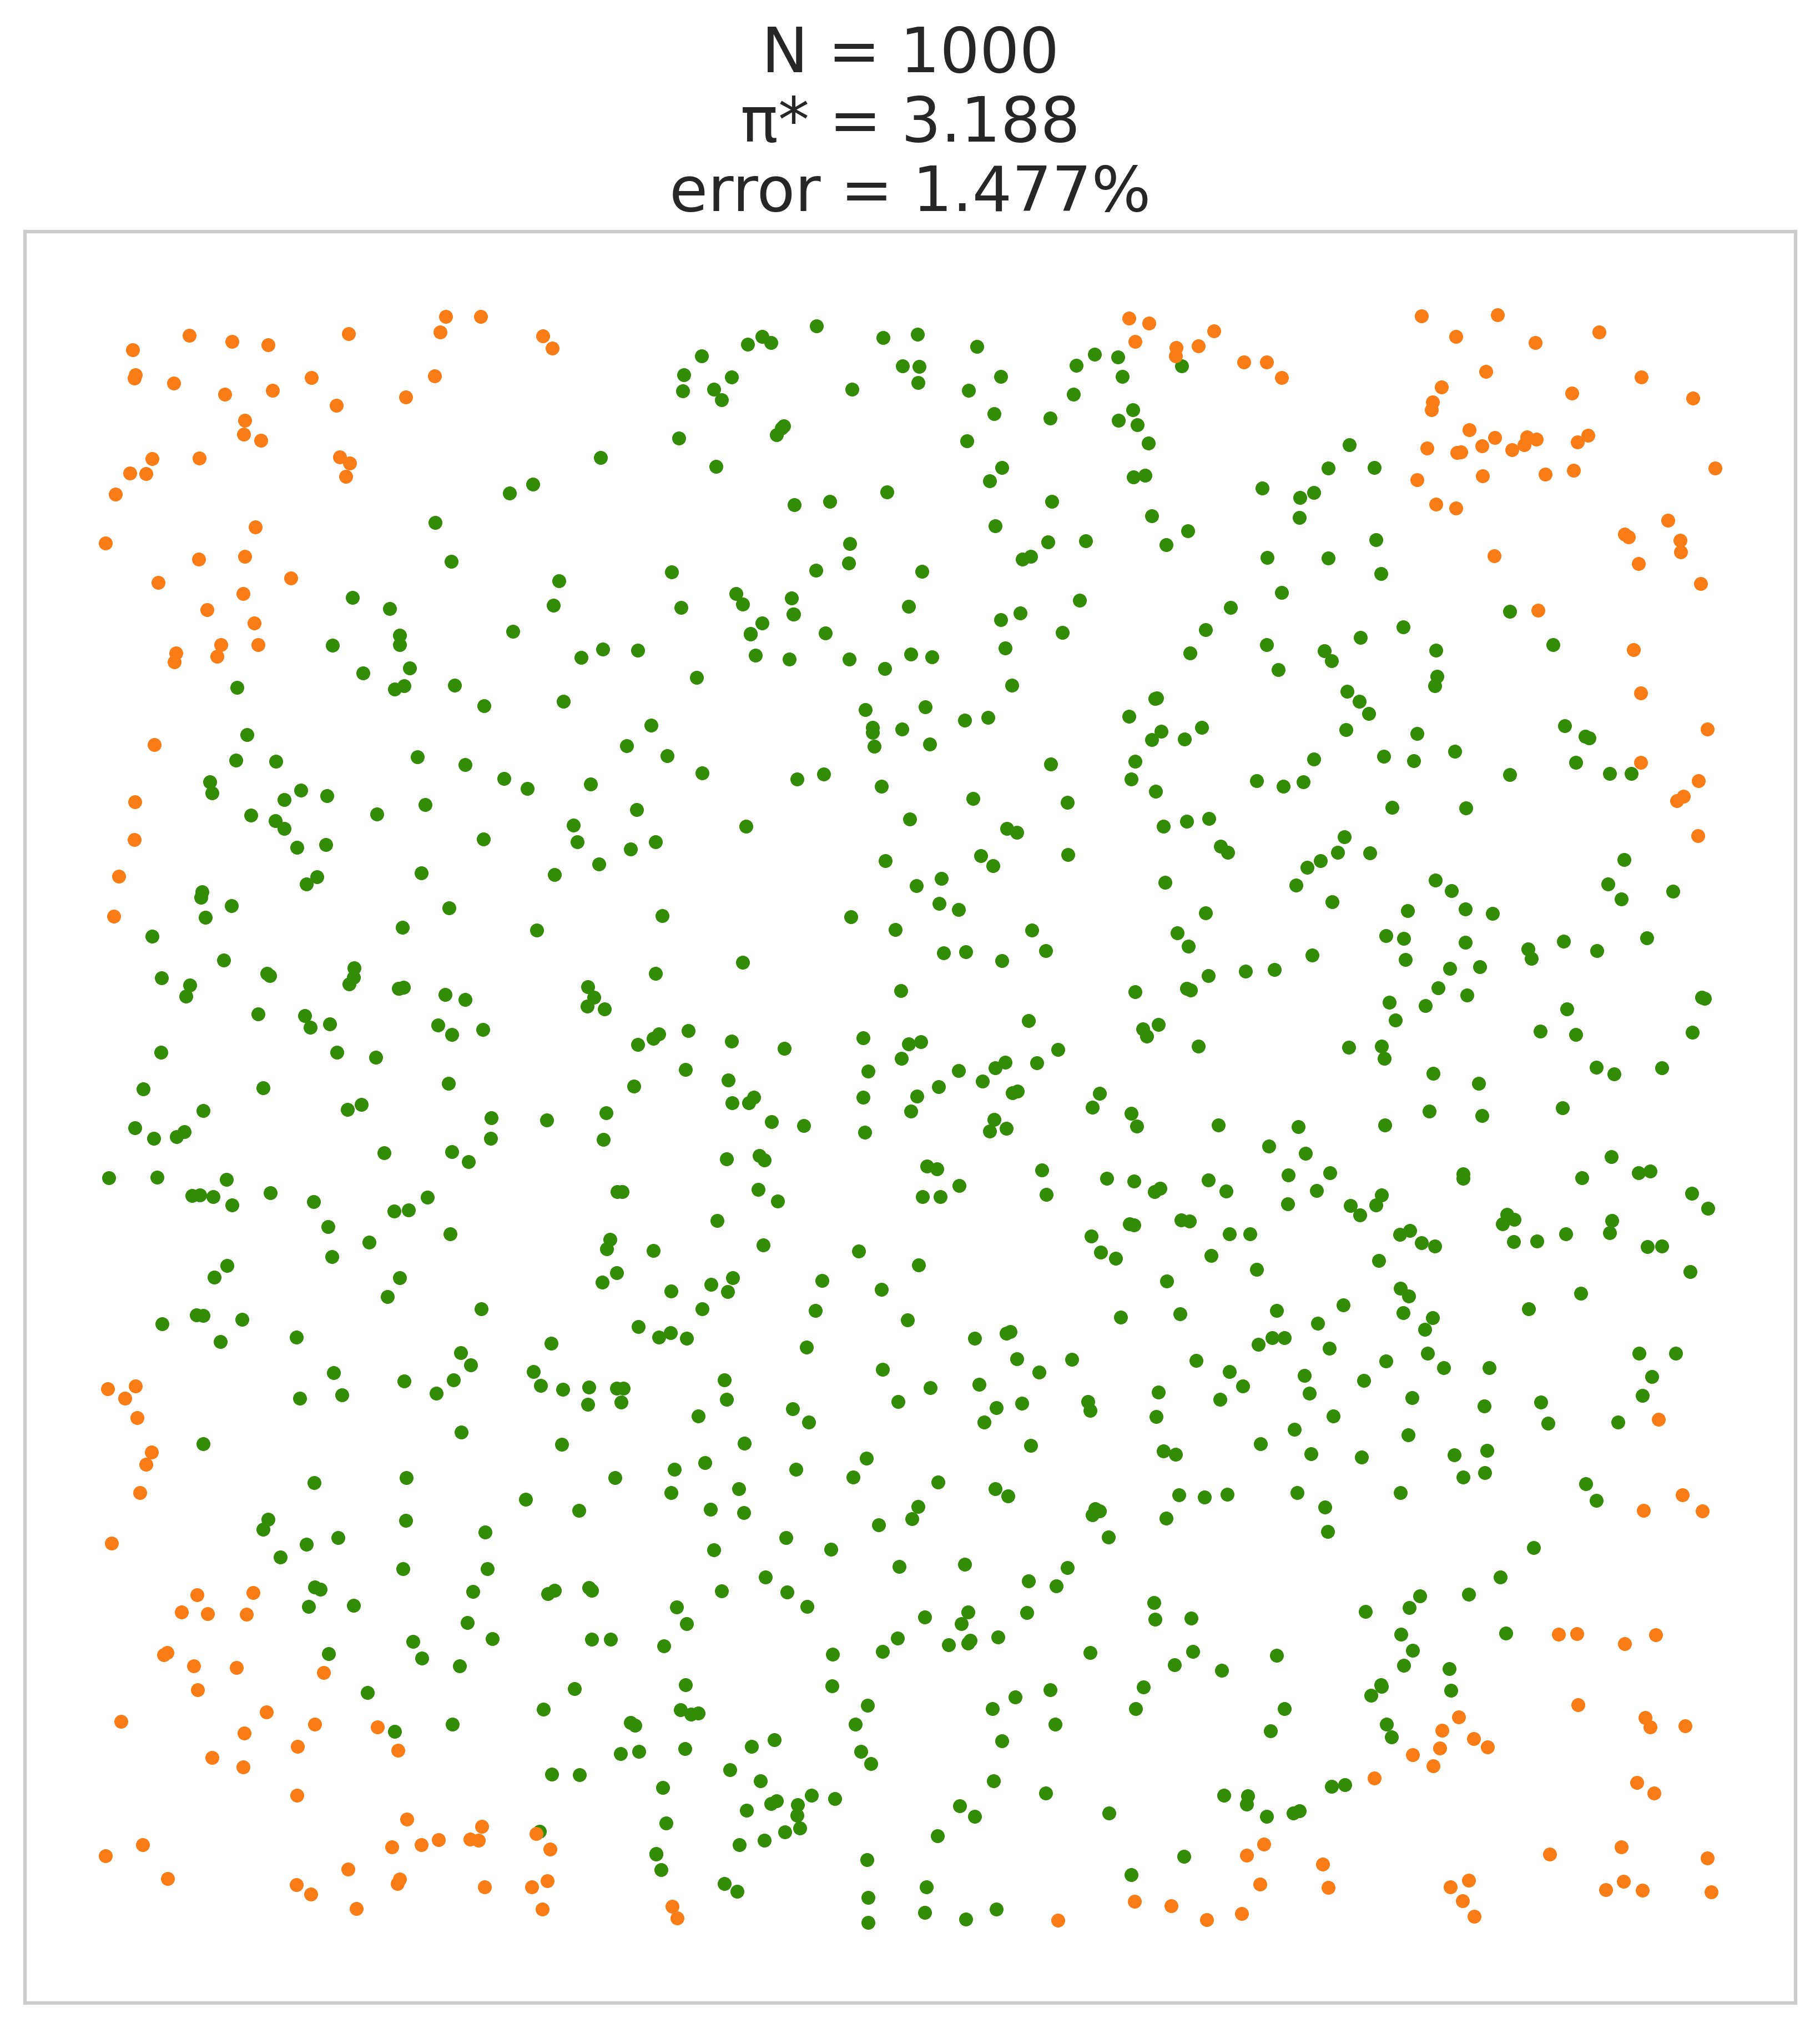
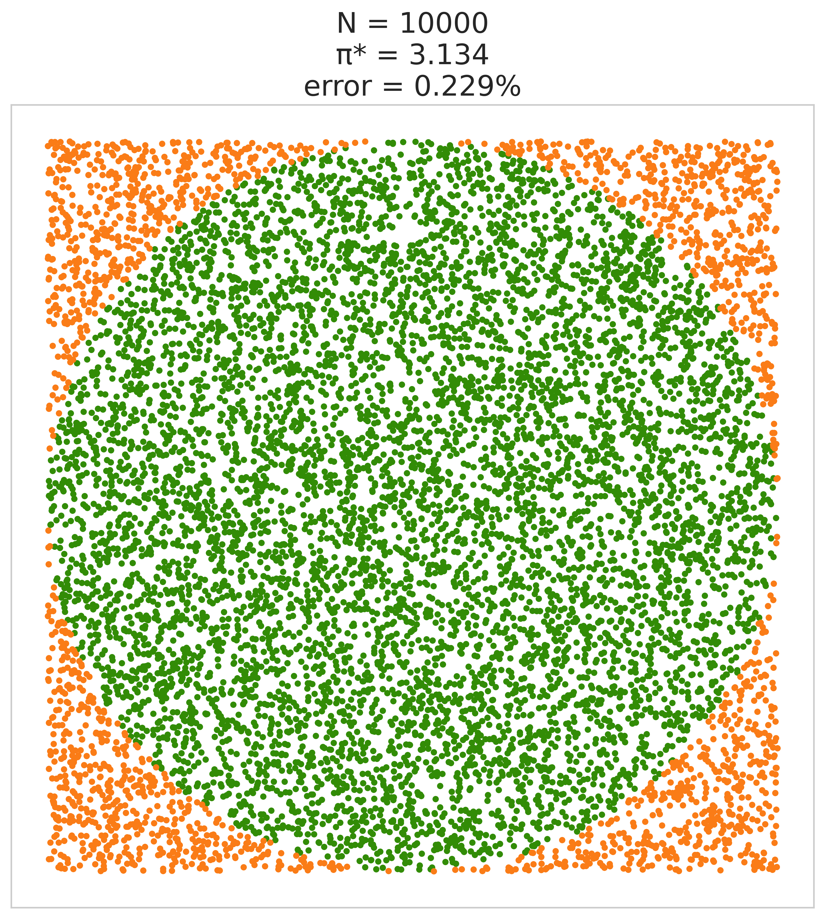
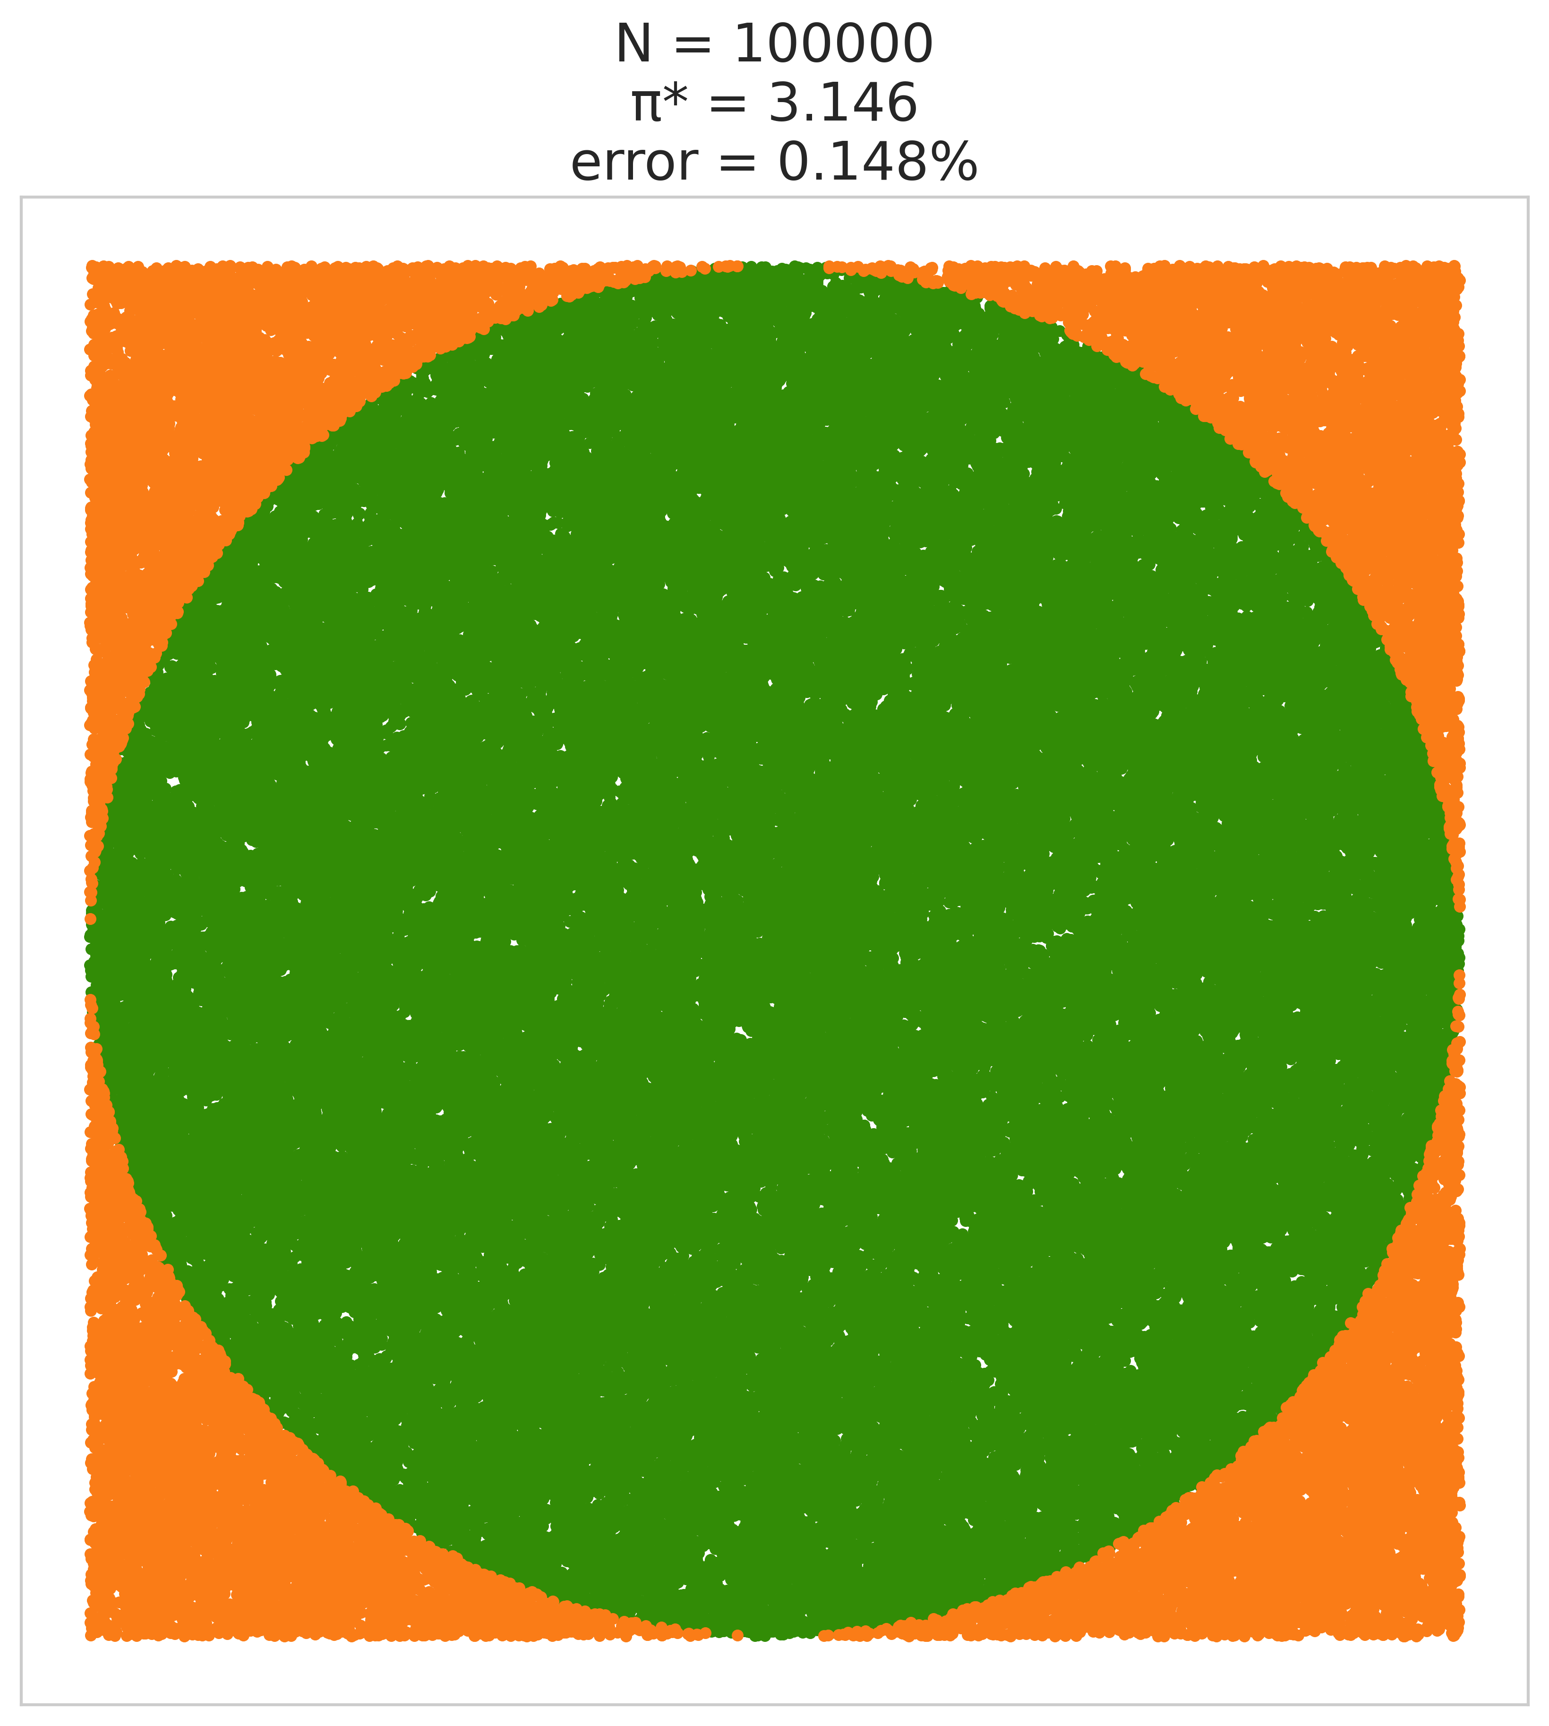
Monte-Carlo algorithms
x, y = np.random.uniform(-1, 1, size=(2, N))
inside = (x**2 + y**2) <= 1
pi = inside.sum()*4/N
error = abs((pi - np.pi) / np.pi) * 100
Add randomness to do a calculation

Slide 20
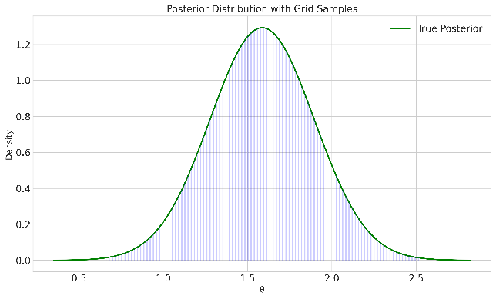
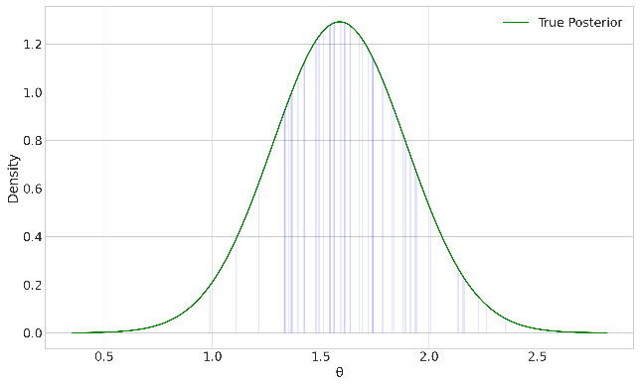
Sampling as an alternative to the grid
More information where there is more probability
We need to have a sampling algorithm
Like if the posterior is a normal distribution or a binomial
Grid sampling
Random sampling

Slide 21
Sampling as an alternative to the grid
More information where there is more probability
We need to have a sampling algorithm
Like if the posterior is a normal distribution or a binomial
We can use the samples to calculate integrals
Random sampling
Approximating integrals

Slide 22
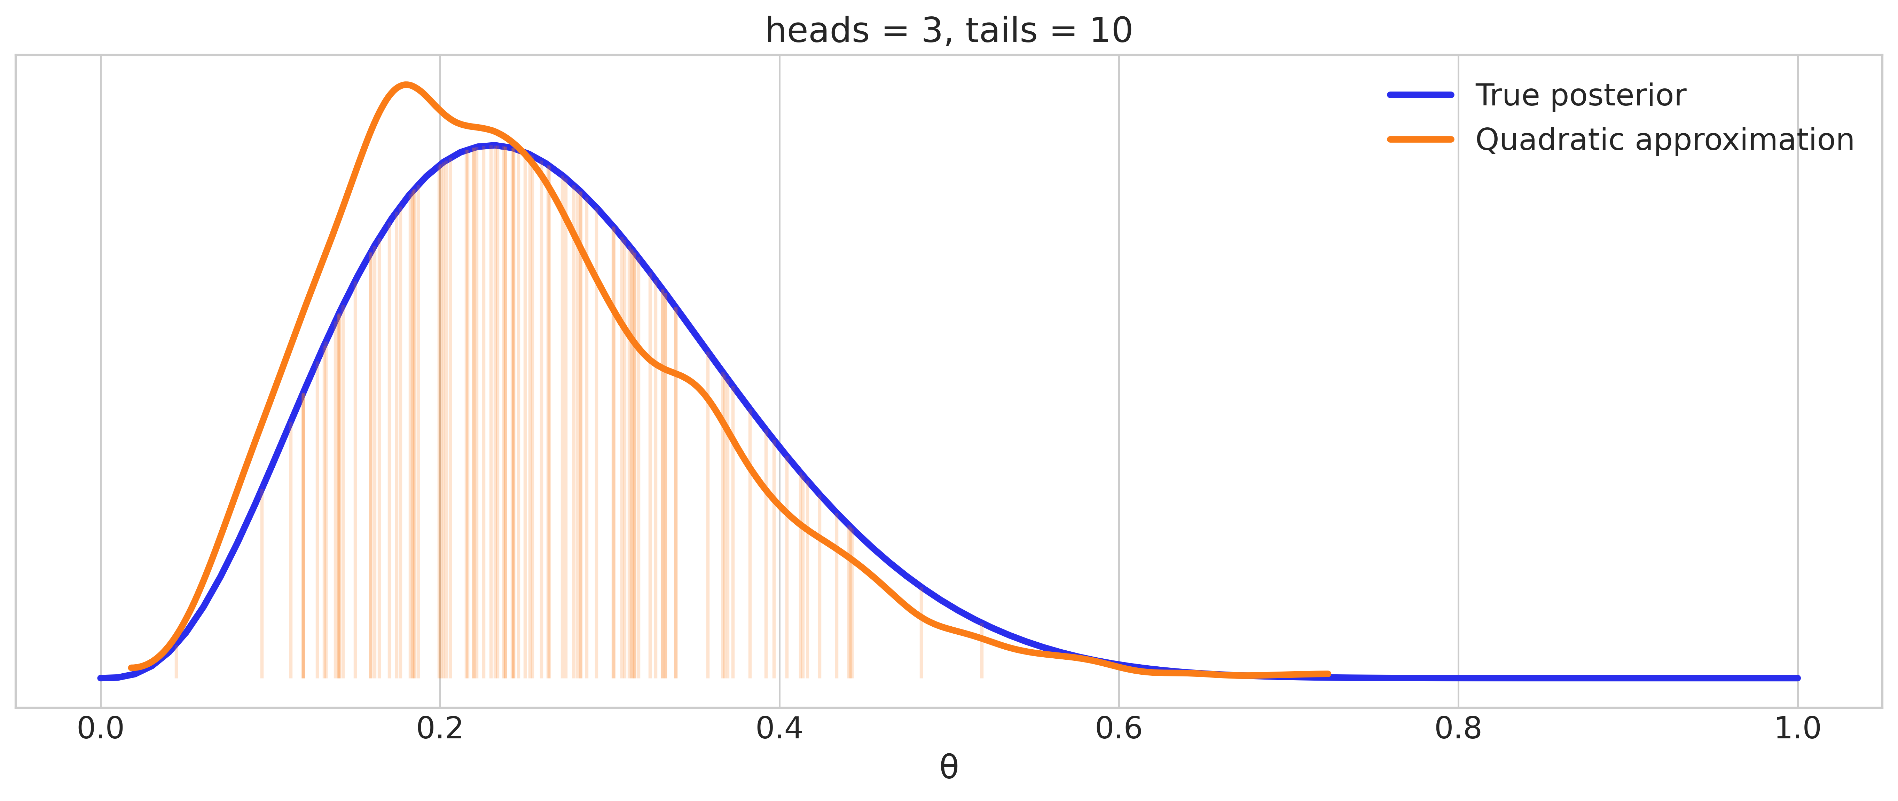
Quadratic approximation
If we don’t have a sampler, we can sample an approximation
And weight samples according to the true probability
If the approximation isn’t good, we are back to grid sampling or worse
Approximating integrals

Slide 23
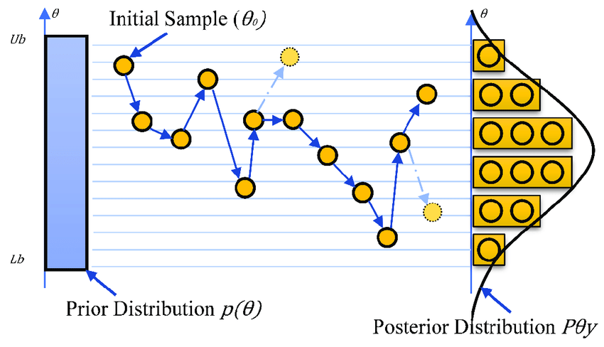
Monte-Carlo Markov Chain
Goal: Draw samples from posterior distribution.
Key idea: Build a Markov chain whose stationary distribution is the posterior.
Uses randomness (Monte Carlo) to approximate complex posteriors.
Essential when analytic solutions are intractable.

Slide 24
MCMC Caveats
Mathematical conditions for correctness:
Posterior must be continuous (no discrete jumps).
Posterior must be finite (normalizable).
Support of the posterior should be connected (avoiding isolated regions).
Practical considerations:
Samples are not independent.
Must discard warm-up (burn-in) samples.
Requires careful checks to ensure the algorithm has converged.
Efficiency depends on model complexity and sampler settings.

Slide 25
5E Metropolis

Slide 26




Sequential sampling
Sample from $p\left(θ\right)$ starting at $θ_{\text{current}}$ which has probability $p\left(θ_{\text{current}}\right)=p_{\text{current}}$
Consider a next step to $θ_{\text{proposed}}$ which as probability $p\left(θ_{\text{proposed}}\right)=p_{\text{proposed}}$
Yes
Go to
$$θ_{proposed}$$
Next place:
$$θ_{proposed}, p_{proposed}$$
$p_{current}<p_{proposed}$?
Start somewhere
$$θ_{current}, p_{current}$$

Slide 27

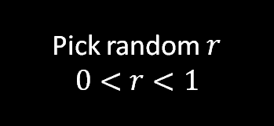




May jump to lower probability point
Yes
Go to
$$θ_{proposed}$$
Pick next place: left or right
$$θ_{proposed}, p_{proposed}$$
$p_{current}<p_{proposed}$?
Yes
No
Pick random $r$
$$0<r<1$$
$r<\frac{p_{proposed}}{p_{current}}$?
No
Go to
$$θ_{current}$$

Slide 28
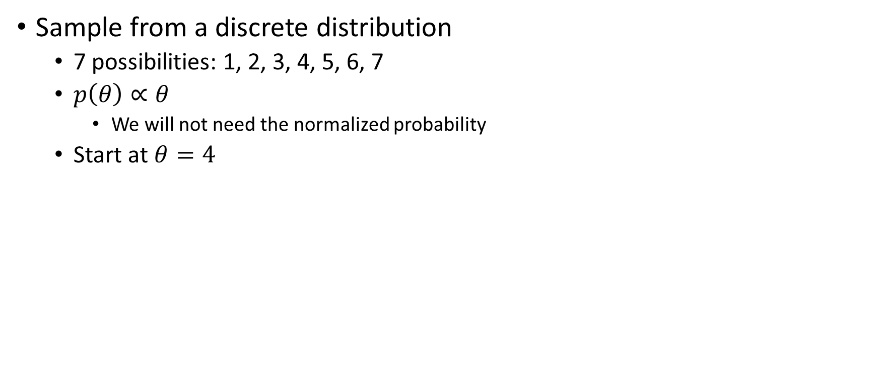
Simple example
Sample from a discrete distribution
7 possibilities: 1, 2, 3, 4, 5, 6, 7
$p\left(θ\right)∝θ$
We will not need the normalized probability
Start at $θ=4$

Slide 29
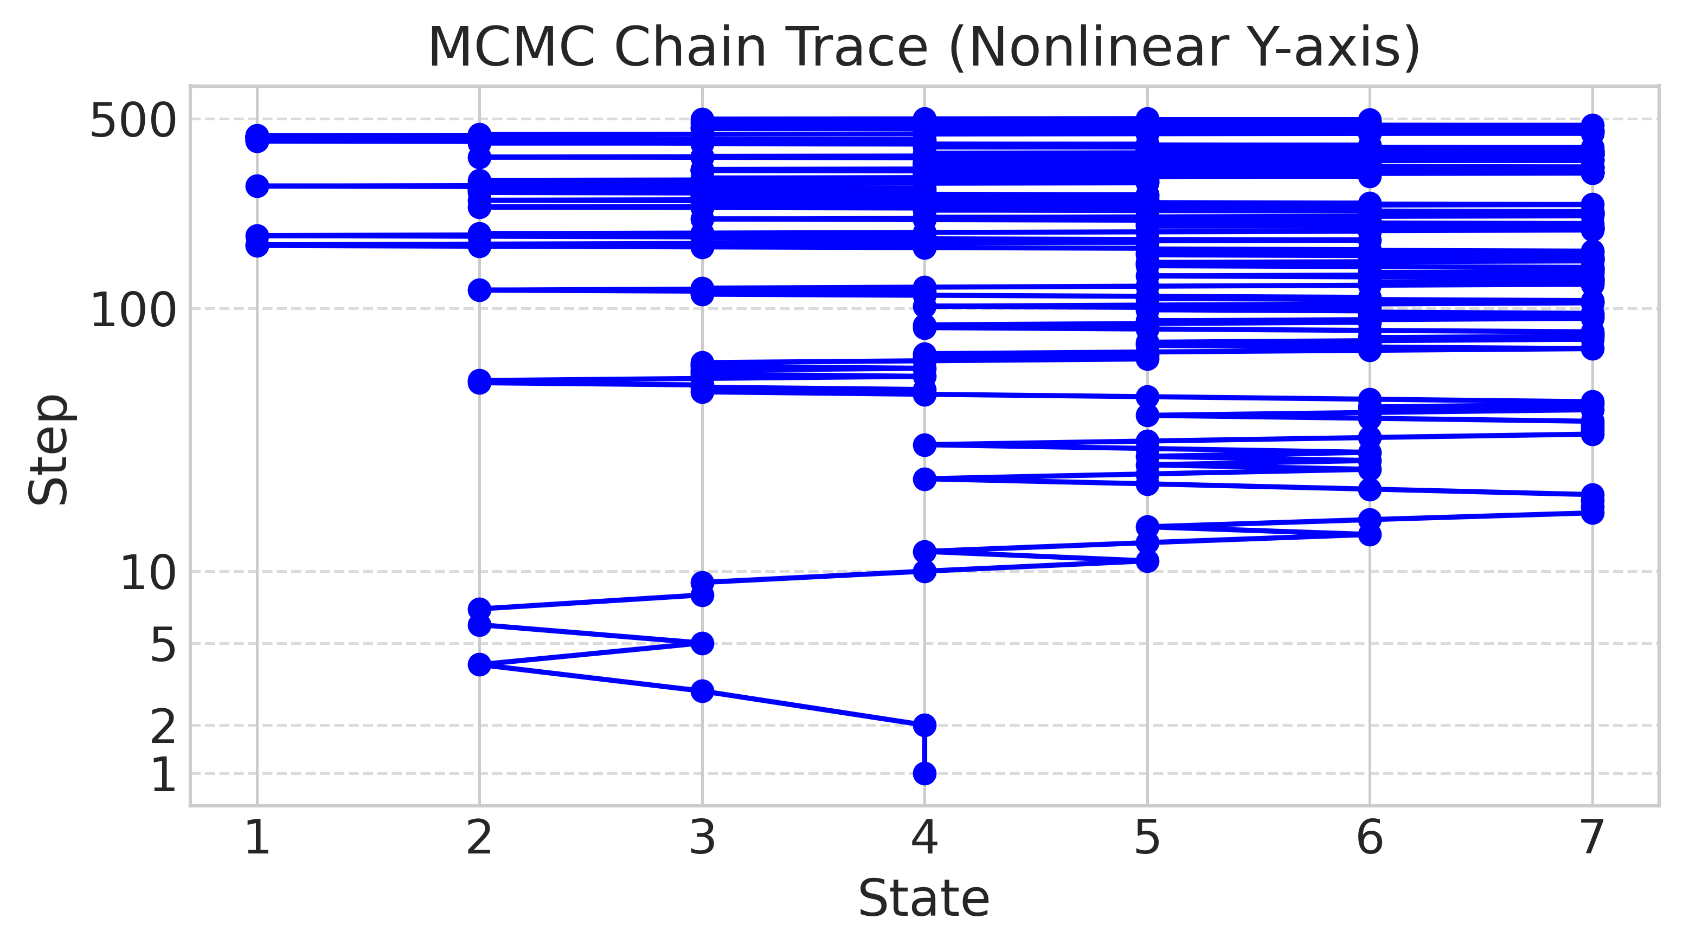
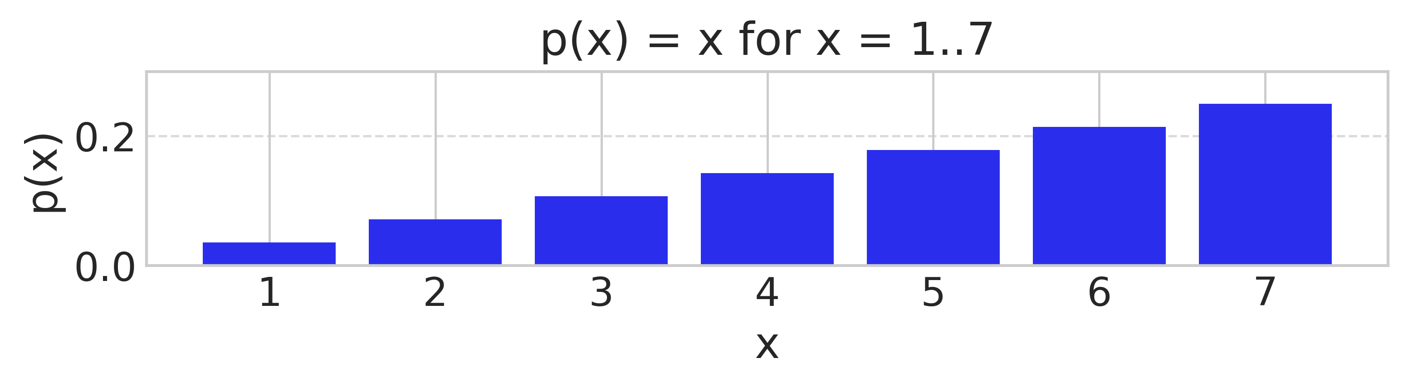
A random walk
Step 1: left, r > 0.75, stay
Step 2: left, r < 0.75, go
Step 3: left, r < 0.66, go
Step 4: right, go
Step 5: left, r < 0.66, go
Step 6: left, r > 0.5, stay
Step 7: right, go
Step 8: left, r < 0.66, stay

Slide 30
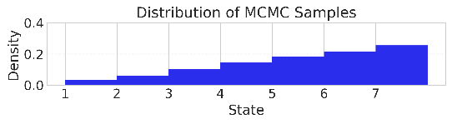

A random walk
Which ends up picking each possibility with exactly its probability

Slide 31
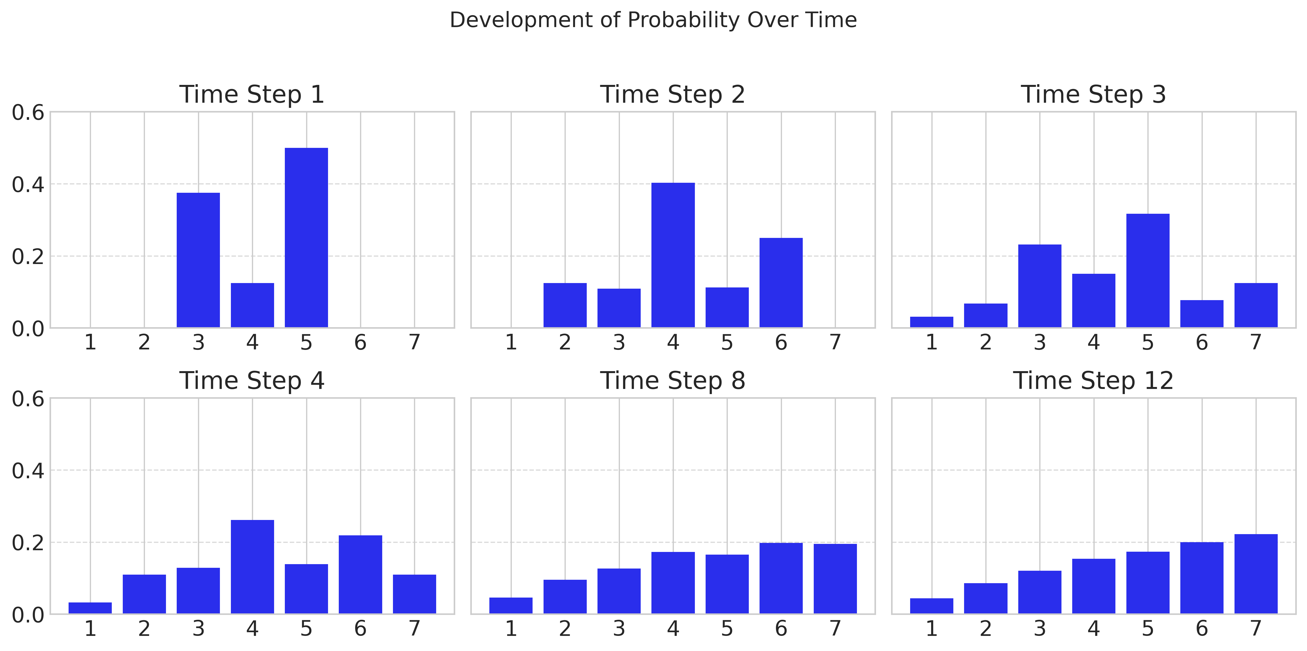
Development of probability over time

Slide 32
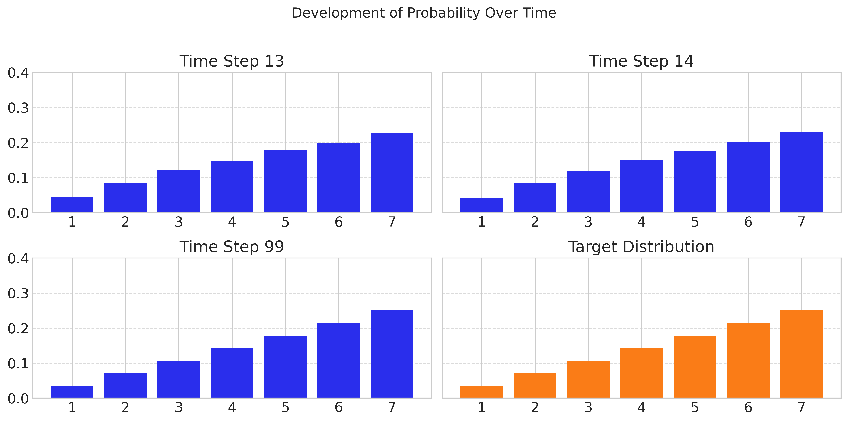
Slowly reach target distribution

Slide 33
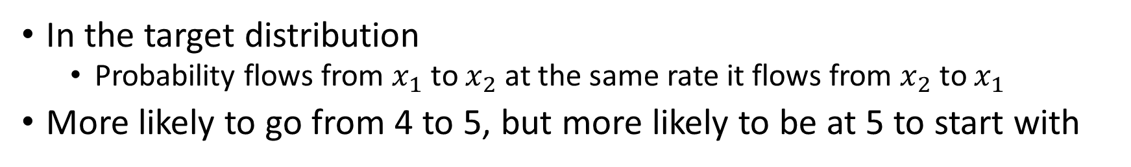

Detailed balance
In the target distribution
Probability flows from $x_{1}$ to $x_{2}$ at the same rate it flows from $x_{2}$ to $x_{1}$
More likely to go from 4 to 5, but more likely to be at 5 to start with
In the example ($p\left(θ\right)∝θ$):

Slide 34
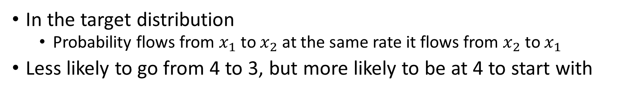
Detailed balance
In the target distribution
Probability flows from $x_{1}$ to $x_{2}$ at the same rate it flows from $x_{2}$ to $x_{1}$
Less likely to go from 4 to 3, but more likely to be at 4 to start with

Slide 35
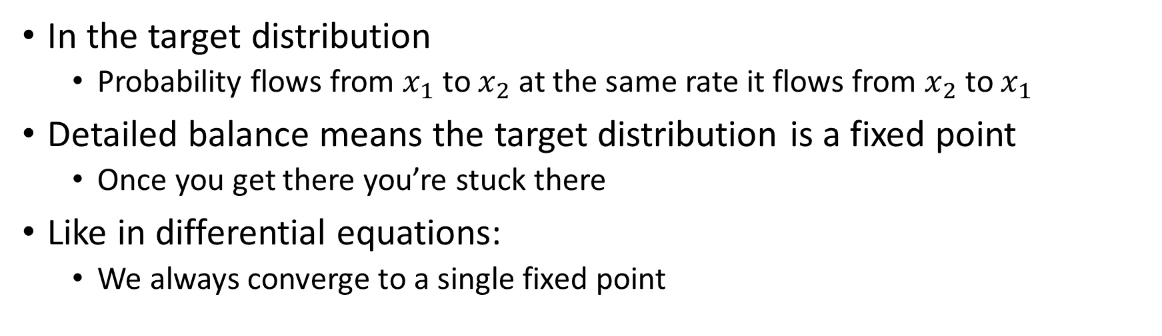
Detailed balance
In the target distribution
Probability flows from $x_{1}$ to $x_{2}$ at the same rate it flows from $x_{2}$ to $x_{1}$
Detailed balance means the target distribution is a fixed point
Once you get there you’re stuck there
Like in differential equations:
We always converge to a single fixed point

Slide 36
Metropolis in action
https://chi-feng.github.io/mcmc-demo/app.html?algorithm=RandomWalkMH&target=banana
Tuning is important
Demonstrate the effect of:
Too broad a proposal
Too narrow a proposal

Slide 37
5F Diagnostics

Slide 38
Bayesian workflow
Diagnostics
Data
Model
Sample
Posterior
Inference
Posterior predictive sampling
Prior predictive sampling

Slide 39
Diagnostics
Did we succeed in sampling the posterior distribution?
Not assessing:
The model
The fit
The interpretation
Only asking
If the sampling algorithm worked
Two major criteria
Mixing of chains
Independence of samples

Slide 40
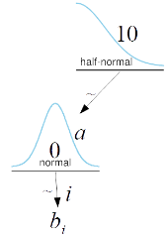
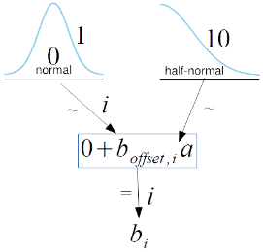
Centered and non-centered models
A common modeling choice
Centered Model
Non-Centered Model
coords = {"data": np.arange(10)}
with pm.Model(coords=coords) as model_cm:
a = pm.HalfNormal('a', 10)
b = pm.Normal('b', 0, a, dims='data')
coords = {"data": np.arange(10)}
with pm.Model(coords=coords) as model_ncm:
a = pm.HalfNormal('a', 10)
b_offset = pm.Normal('b_offset', mu=0, sigma=1, dims='data')
b = pm.Deterministic('b', 0 + b_offset * a, dims='data')

Slide 41
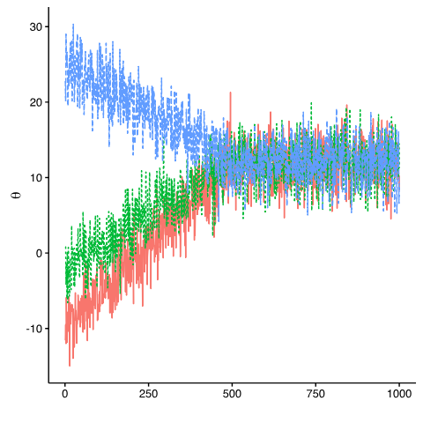
How close are the chains?
Important for:
Exploring posterior
Convergence diagnostics
Parallelization
Each one will have a different starting point
Starting points should be “reasonable”
Otherwise convergence can take a long time

Slide 42
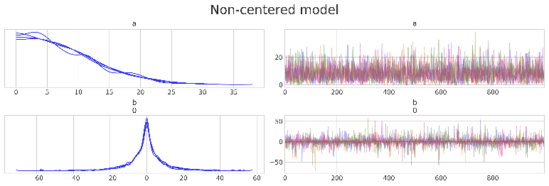
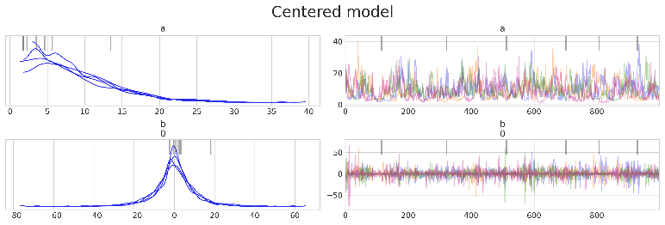
Good and bad trace plots
BAP Figure 10.7 and 10.8
ax = az.plot_trace(idata_cm, var_names=['a', "b"], coords=coords, divergences='top', chain_prop={"ls": "-"})
ax[0, 0].get_figure().suptitle('model_c', fontsize=20)
- “Stuck” sampling
- Lack of overlap

Slide 43
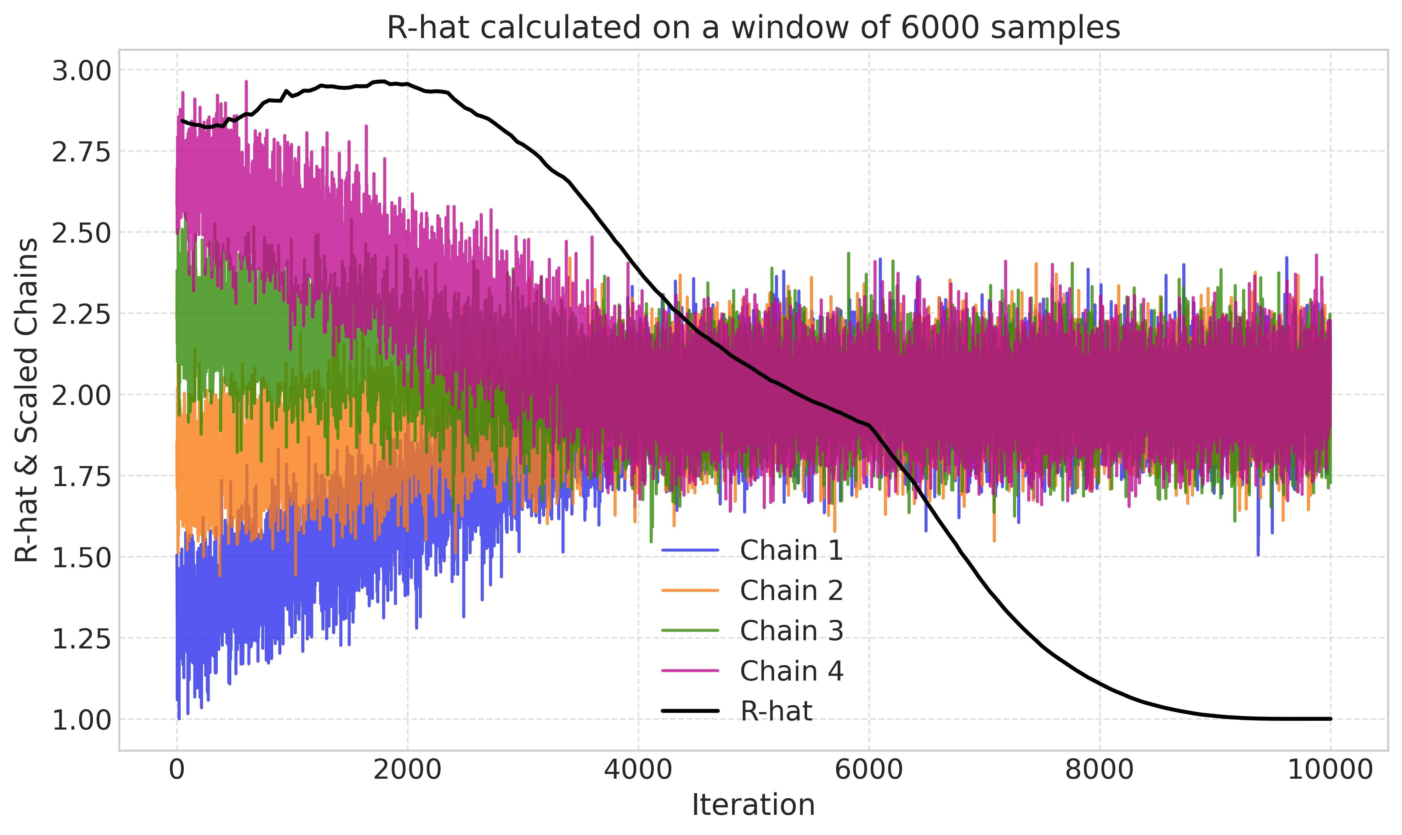
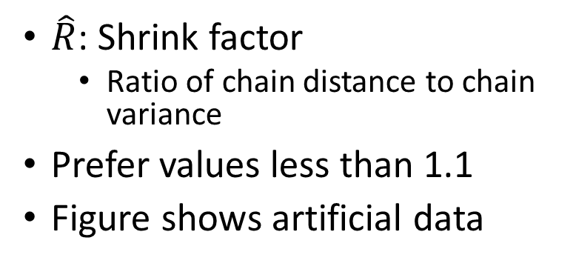
Measuring if the chains are mixed
$\hat{R}$: Shrink factor
Ratio of chain distance to chain variance
Prefer values less than 1.1
Figure shows artificial data
rhat = az.rhat(idata)
rhat.x.values

Slide 44
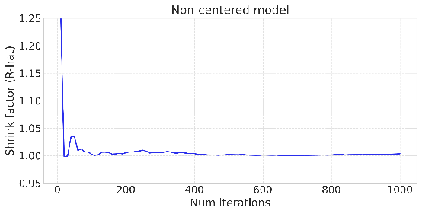
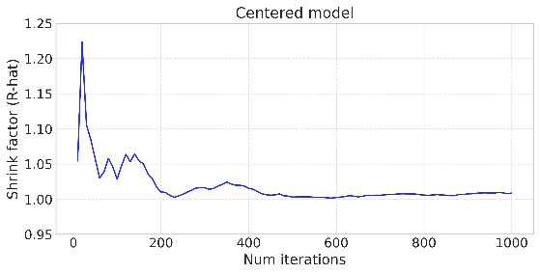
Measuring if the chains are mixed
Graphed from beginning of sampling
So stabilizes over time
Comparing differences in sampling

Slide 45
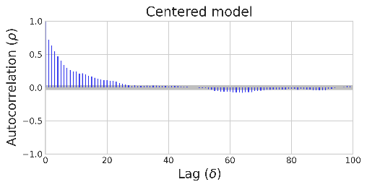
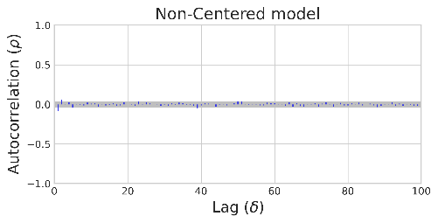
Autocorrelation
How much can you predict this sample from the previous samples?
How far away do you have to get to a truly independent sample

Slide 46
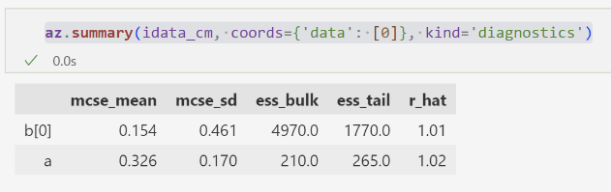
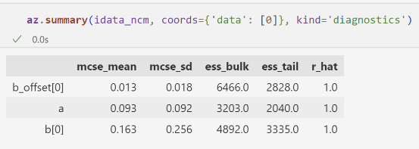
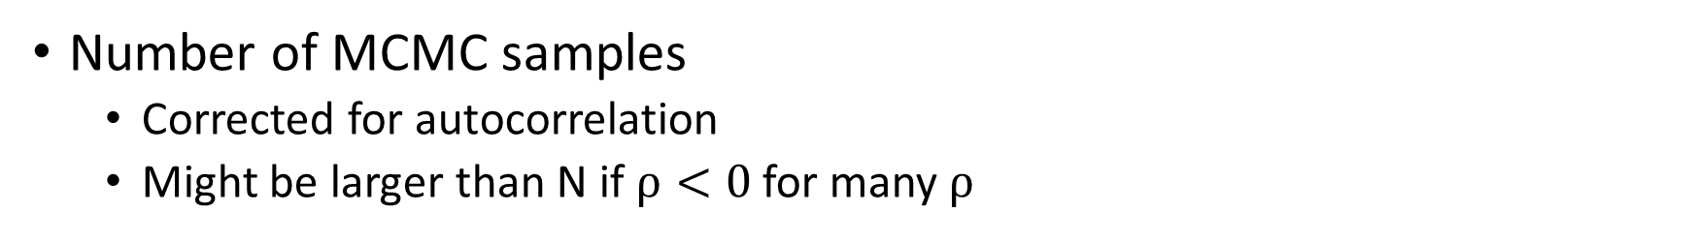
Effective sample size (ESS)
Number of MCMC samples
Corrected for autocorrelation
Might be larger than N if $ρ<0$ for many $ρ$

Slide 47
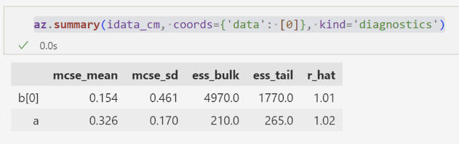
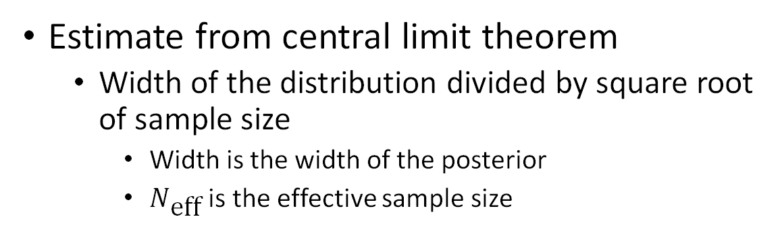
Monte carlo standard error (MCSE)
Estimate from central limit theorem
Width of the distribution divided by square root of sample size
Width is the width of the posterior
$N_{\text{eff}}$ is the effective sample size

Slide 48
Diagnostics summary
First look
Trace plot
Look for:
Chain overlap
Consistent pattern of noise
Similar posteriors
Rhat
Measures overlap of chains
Should be less than 1.1
ESS
Measures within chain correlation
Gives information about how much information there is
Should be more than 500
MCSE
How well are we measuring the parameter
Should be less than 1-2%

Slide 49
Diagnostics: what to do?
Check yourself
Increase number of samples
Increase number of tuning samples
Pick better initial points
We won’t cover this
Change the model
Try a simpler model first
Change the priors
Change the parameters

Slide 50
Bayesian workflow
Diagnostics
Data
Model
Sample
Posterior
Inference
Posterior predictive sampling
Prior predictive sampling

Slide 51
Kahoot time!!
Back in a second!

Slide 52
5G Hamiltonian Monte Carlo

Slide 53
There are many MCMC Algorithms
Metropolis
Metropolis et al, 1953
Metropolis-Hastings
Metropolis with a non-symmetric proposal function
Hastings, 1970
Gibbs Sampling
Sample each parameter given the other parameters
Fewer rejections but more analytic work
Geman and Geman, 1984
Hamiltonian Monte Carlo (HMC)
Uses a complex physical model for a proposal function
Much more efficient
Duane et all, 1987
No U turn Sampler
Solves a serious problem in the HMC
Hoffman and Gelman, 2014

Slide 54
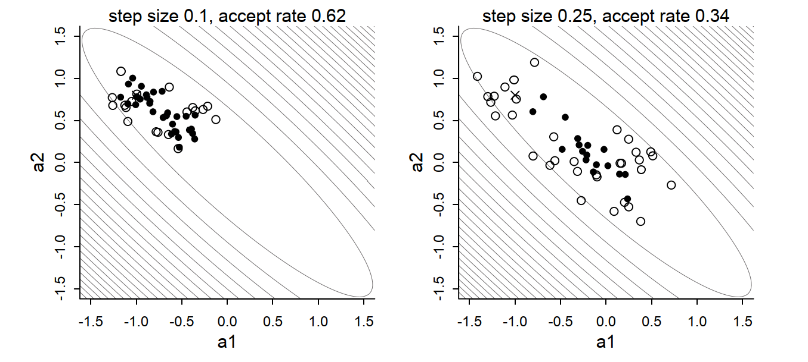
Limitations of Metropolis algorithms
As the dimensionality gets higher
The “good” jumps get harder to find
Parameter covariances get harder to esimate

Slide 55
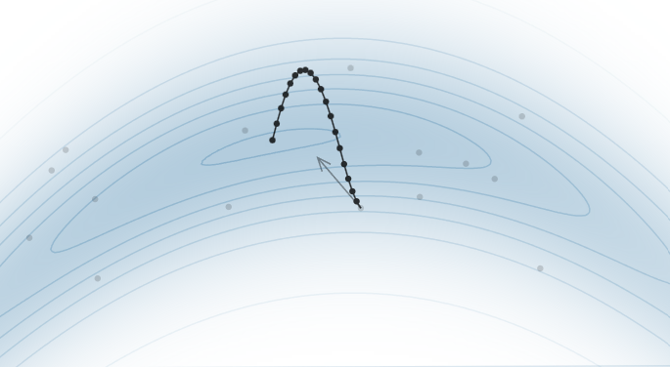
The HMC solution
Take many small steps that are good
Use the gradient of the probability!
Every small step keeps is in “good” probabilities

Slide 56
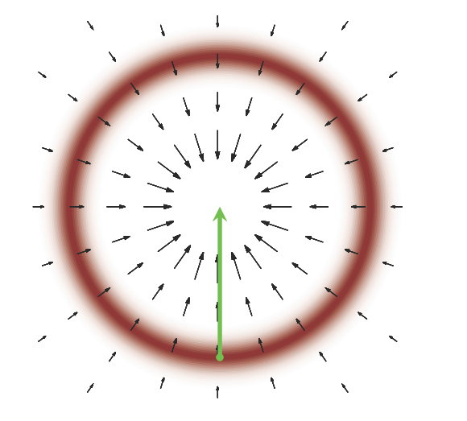
The HMC solution
Take many small steps that are good
Don’t go up the gradient!
Most of the probability is not at the mode

Slide 57
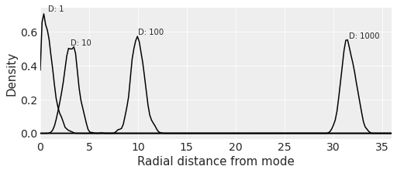
Most of the probability is not at the mode
PDF of multi-dimensional gaussians
As a function of distance
def rad_dist(Y):
return np.sqrt(np.sum(Y**2))
xvar = np.linspace(0, 36, 200)
# the book code is wrapped in a loop to reproduce Figure 9.4
for D in [1, 10, 100, 1000]:
T = int(1e3)
Y = stats.multivariate_normal(np.zeros(D), np.identity(D)).rvs(T)
Rd = list(map(rad_dist, Y))
kde = stats.gaussian_kde(Rd)
yvar = kde(xvar)
ax.plot(xvar, yvar, color="k")
ax.text(np.mean(Rd), np.max(yvar) * 1.02, f"D: {D}")

Slide 58
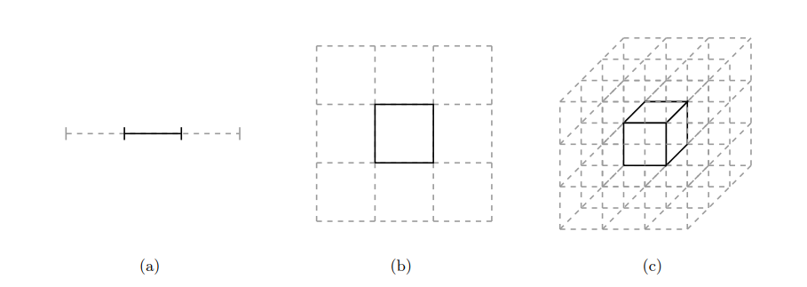
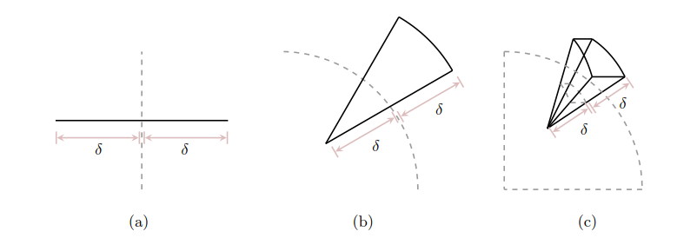
Because most of the volume isn’t at the mode
Consider a N-D cube
What percentage is in the middle?
Consider a spherical shell
Let dimensionality increase
Look at exterior and interior volume

Slide 59


Expectations are dominated by a “typical set”
Visualization of a typical set in high dimensions

Slide 60


The HMC solution
Take many small steps that are good
Don’t go up the gradient!
Go perpendicular to the gradient
Like a satellite

Slide 61

The satellite needs momentum
Too little momentum and we end up near the mode
Too much momentum and we fly out into space

Slide 62

Simulate Physics
Leapfrog integration
Half step in direction of momentum
Re-calculate momentum in new location
Repeat
This is just a proposal function
At the end apply Metropolis rule

Slide 63
Tuning the algorithm
Algorithm parameters:
Number of steps
Size of step
Tuning for:
Minimize correlation between samples
High target acceptance ratio
Default: 0.9

Slide 64
Summary of HMC
Special proposal function for Metropolis
Simulates physics to stay in the ‘typical set’
Goals
Minimize autocorrelation
Maintain very high acceptance ratio
Parameters
Number of steps
Step size

Slide 65
No U-Turn Sampler (NUTS)
A variant of HMC
Explores multiple possible jumps in two direcitons
Default state-of-the-art sampler in PPCs
Parameters
Target acceptance probability
Controls step size
Higher gives slower but better sampling
Maximum tree depth
Controls the number of steps
Higher gives slower but better sampling

Slide 66
5H Divergences

Slide 67

Leapfrog integration can fail
If probability is changing too quickly
Noise will compound and satellite “energy” will change
Change in ‘energy’ is called a divergence

Slide 68
Leapfrog integration can fail
Depends on the step size and number of steps

Slide 69
See divergences during sampling
Famous quote:
the rule of thumb is that divergences are nothing to worry about as long as you have fewer than about one of them.

Slide 70
See divergences in trace plot
Identify problematic regions in parameter space
Small b

Slide 71

Divergences in pair plot
az.plot_pair(
idata_cm,
var_names=["b", "log(a)"],
coords={"data": [0]},
divergences=True,
scatter_kwargs={"color": "cyan"},
divergences_kwargs={"color": "k", "marker": ".", "mec": None},
ax=axes[0],
)
axes[0].set_title("model_c")
Divergences reveal problematic parts of parameter space

